Slide 1
PRIORITY SUBSTANCES INVENTARIZATION AND MONITORING PROGRAMME OPTIMIZATION
2016

Slide 2
Main tasks
Analysis of available data on priority and hazardous substances in Lithuanian environment, determination of pollution sources (both – point and diffuse sources) and amounts;
Monitoring of priority and hazardous substances in water, bottom sediments and biota, as well as in wastewaters and wastewater sludge in Lithuania during year 2015;
Assessment of water chemical quality, taking into account long-term data and results from implemented projects, trend analysis;
Preparation of optimized monitoring program for priority and hazardous substances for period 2016-2021, taking into account results from first three tasks, for rivers, lakes, Couronian lagoon and Baltic Sea.
These steps will help to implement requirements of WFD and it’s daughter directive – EQS directive, and results will be useful for River basin management plans.

Slide 3
Task 1 – Data analysis
Finished (presented in midterm report):
Data analysis on point source data and diffuse point pollution (agriculture and atmosphere)
Data analysis form AIVIKS data base about used, placed on market, imported and exported priority substances
Summarized results from previous projects in all matrixes

Slide 4
Task 1 – Problems occurred
Data about point pollution in years 2013 and 2014 was not complete
Poor data from IS AIVIKS database, especially, data on import and export, which reduces possibility to prepare an inventory on priority substances
Lack of data about diffuse pollution from atmosphere

Slide 5
Task 2 - Monitoring
Within current project all 45 priority substances from EQS Directive 2013/39/EU are analyzed
Monitoring of surface waters, sediments and biota in rivers and lakes, Baltic Sea and Couronian lagoon, is almost finished:
~250 samples have been collected and analyzed during year 2015 (98 %). Missing samples from Baltic Sea were collected on March 2016.
Watch list monitoring (EC decision 2015/495)
has started on beginning of March, first 4 samples (33%) were collected

Slide 7
Task 2 - Monitoring
Waste water monitoring started in July 2015
78 sampling sites have been monitored during year 2015 2 times each (96% of samples collected), missing samples will be collected on April and May 2016.
Amounts of samples planned:
160 waste water samples;
90 surface water samples;
40 sewage sludge samples;
40 bottom sediment samples.
Notes:
Jāpaskaidro paraugu skaits – ka ne vienmēr notekūdeņi no uzņēmuma tiek novadīti ūdenstilpnēs utt)

Slide 8
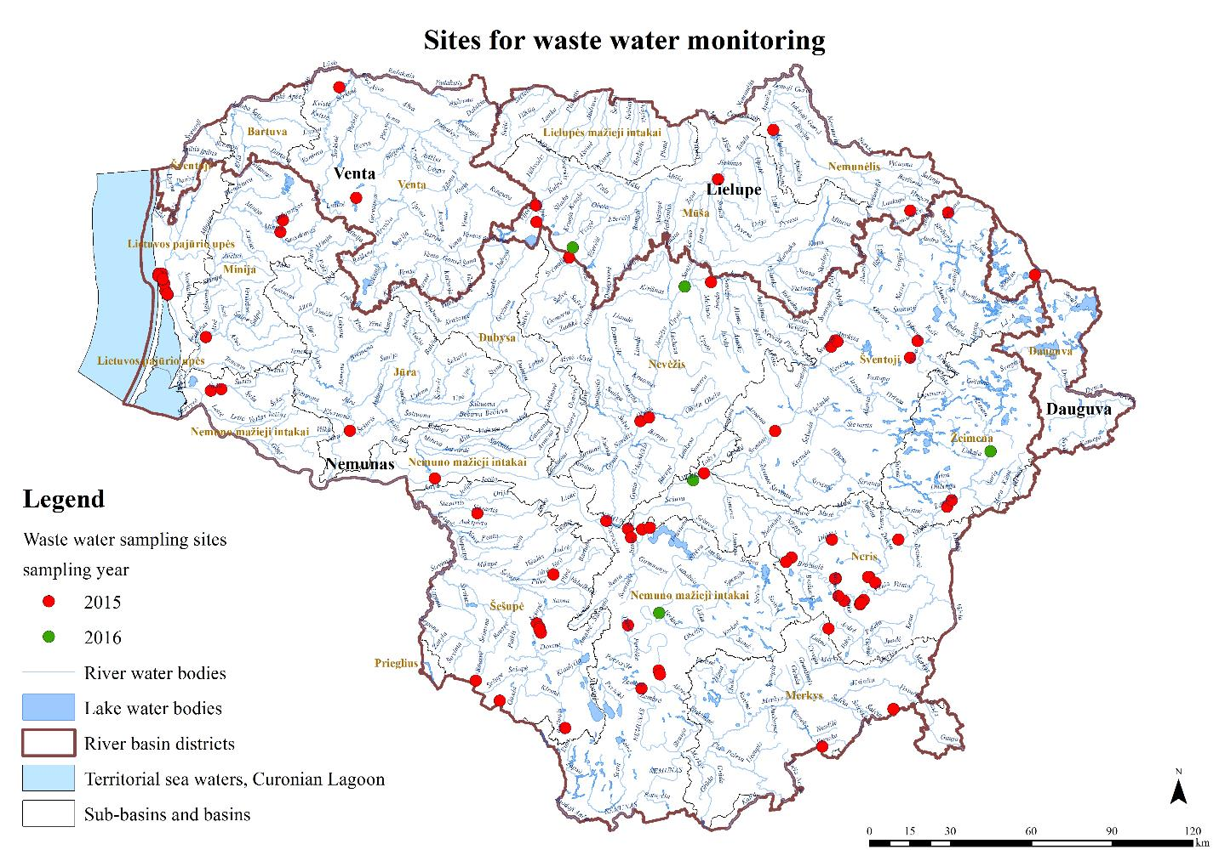

Slide 9
Amounts of samples (SW and WW)
Parameter | Samples in Total
C10-C13 Chloroalkanes | 357
DEHP | 196
PAH | 491
PFOS/PFOA | 399
Phenols | 333
Pesticides | 520
VOCs | 248
HBCDD | 496
POPs | 423
Tributyltin | 472
The test reports will be prepared after all analyses will be finished
Notes:
Trūkst Dioksīni un Heksabromciklododekāns.

Slide 10
Task 3 – Assessment of water chemical quality
Monitoring and project results during last 15 years (2000-2015) are evaluated
Data analysis by monitoring stations and by matrices (water, sediments and biota) is almost finished
- Content and format of the data analysis has been accepted by contracting organization (80 % of work already done)

Slide 11
Task 3 – Assessment of water chemical quality
Medžiagų koncentracijų DLK-AKS ir MV-AKS viršijimai 2001-2013 m.
LTR127 Skirvytė ties Rusne
Metai | Medžiaga
 | Cd ir jo junginiai (Nr. 6) | DEHP (Nr. 12) | Pb ir jo junginiai (Nr. 20) | Hg ir jo junginiai (Nr. 21) | Poliaromatiniai angliavandeniliai (Nr. 28)
2001 |  |  |  | DLK-AKS
2003 |  |  | MV-AKS
2007 | DLK-AKS
2011 |  | MV-AKS
2012 |  |  |  | DLK-AKS
2013 |  |  |  |  | DLK-AKS
Prepared for each monitoring station with multiple EQS exceedances

Slide 12
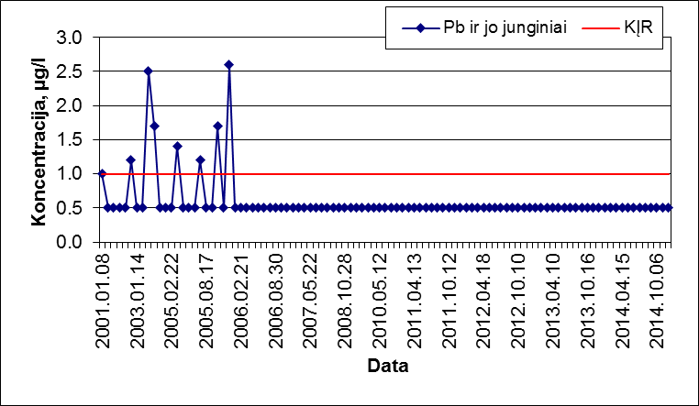
Task 3 – Assessment of water chemical quality
LTR127 Skirvytė ties Rusne
Pb ir jo junginių (medžiaga Nr. 20) monitoringo vandenyje duomenys 2001‑2014 m.
Pb ir jo junginių (medžiaga Nr. 20) vidutinių metų koncentracijų vandenyje duomenys 2001-2014 m.
Notes:
Vairumā monitoringa staciju trendu analīzi iespējams veikt tikai smagajiem metāliem, piemēram svinam (lead), jo dati ir pieejami sākot no 2000 vai 2001 gada.
Pirmajā grafikā visi monitoringa rezultāti par svinu (koncentrācijas virs kvantificēšanas robežas līdz 2006. gadam. Otrajā grafikā gada vidējās koncentrācijas, kur 2003 gadā bijis annual average EQS pārsniegums, taču svina (lead) koncentrāciju tendence rāda koncentrāciju samazināšanos.

Slide 13
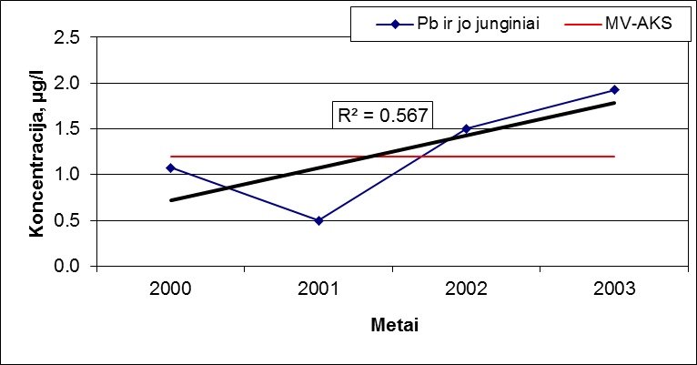
Task 3 – Assessment of water chemical quality
LTR49 Neris žemiau Jonavos
Pb ir jo junginių (medžiaga Nr. 20) monitoringo vandenyje duomenys 2000‑2003 m.
Pb ir jo junginių (medžiaga Nr. 20) vidutinių metų koncentracijų vandenyje duomenys 2000-2003 m.
Notes:
Ir ļoti daudz monitoringa staciju, kur novērojumi veikti tikai līdz 2004. gadam (pirms ieviesta ūdens struktūrdirektīvas monitorings) un nav vairāk informācijas. Lielā daļā staciju smago metālu koncentrācijas pārsniedz gada vidējās vērtības un ar tendenci koncentrācijām pieaugt. Būtu nepieciešama papildus informācija, vai stacija iepriekš nav bijusi mixing zonā, vai arī papildus skreenings šī brīža situācijā.

Slide 14
Task 3 – Assessment of chemical quality - biota
LTR49 Neris žemiau Jonavos
Notes:
Dzīvsudrabs biotā – visos gados ir bijis EQS pārsniegums, taču ar tendenci samazināties. Ļoti līdzīga situācija ir arī Latvijā ar dzīvsudraba koncentrācijām biotā. (lai pārāk netracinātu cilvēkus)

Slide 15
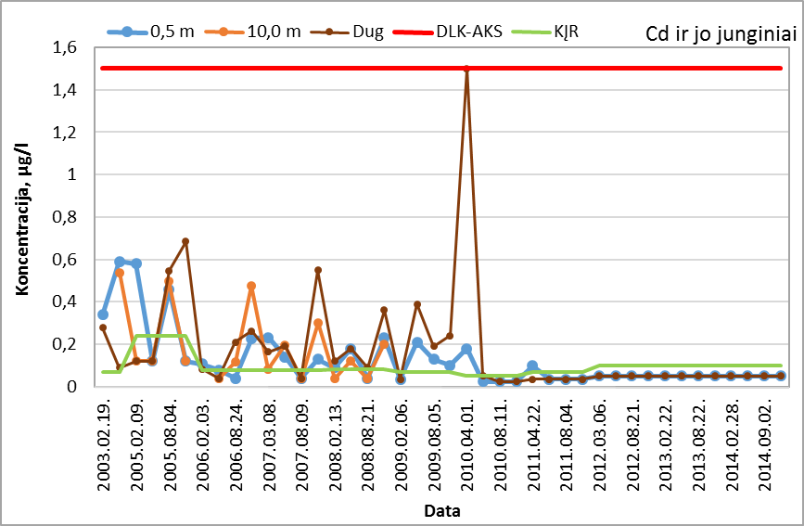
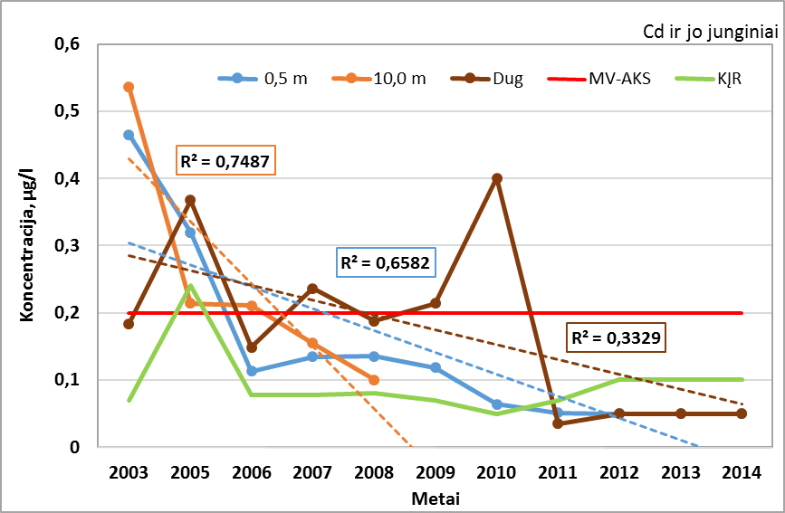
Task 3 – Assessment of water chemical quality
Baltijos jura (monitoringo vietos Nr. 7)
Notes:
Pirmajā grafikā visi monitoringa dati 3 dziļumos (atšķirībā no iekšzemes), piegrunts slānī 2010. gadā sasniegta maksimāli pieļaujamā vērtība. Otrajā grafikā gada vidējās vērtības pa dziļumiem. Redzami gada vidējo koncentrāciju pārsniegumi līdz pat 2010. gadam, taču ar tendenci samazināties.

Slide 16
Task 3 – Assessment of chemical quality sediments
Baltijos jura (monitoringo vietos Nr. 7)
Notes:
Arī sedimentos kadmija koncentrācijas samazinās.

Slide 17
Task 4 – monitoring program optimization
Surface water monitoring program by water type (Baltic sea, Couronian Lagoon, Rivers and Lakes) and by matrices (water, bottom sediments, biota) will be developed
Surface water monitoring program will be compared with 2 EU countries
Will start, when most part of previous tasks will be finished

Slide 18
Summary
All task results will be summarised and supplemented by GIS data
In general implementation of project is progressing according to prolonged plan, all tasks are expected to be completed on time
Communication with contracting organization is in good level

Slide 19
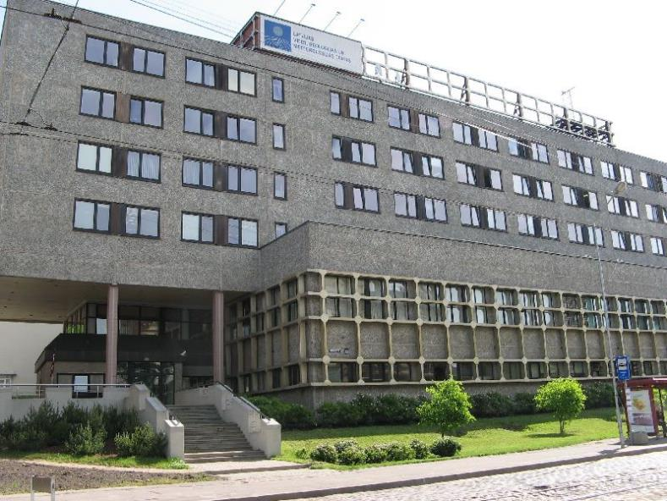
VSIA “LATVIJAS VIDES, ĢEOLOĢIJAS UN METEOROLOĢIJAS CENTRS”
Maskavas 165, Rīga
www.meteo.lv
www.lvgmc.lv
lvgmc@lvgmc.lv
Tālr. 67032600,
Fakss 67145154

